Slide 1
Mini Project: Online Food Store
Shekhar Chandoo Gite(186123)
Rohan Rajendrasa Wakhare(186158)
Mayur Suresh Patil(186139)
Digvijay Ravindra Dhanger(186118)
Guided By: Miss.Mayuri Ighe

Slide 2
OBJECTIVE
The aim of the project is to Real food are now at your doorstep.
THE PROJECT ONLINE food Store is the process whereby consumers directly buy goods, services etc. from a seller interactively in real-time without an intermediary service over the internet. The goal of this application is to develop a web based interface for online retailers and consumers. The system would be easy to use and hence make the shopping experience pleasant for the users.
the goal of this application is: To develop an easy to use web based interface where users can search for products, view a complete description of the products and order the products.
An user can view the complete specification of the product along with various images .

Slide 3
USER OPERATIONS
User Signup : A user can signup himself first and may login with his given e-mail id and password.
User’s login : User’s can shopping by entering his email id and password with which they are signup.
Your Order: The facility is provided to user so that he can choose what he wants to purchase.

Slide 4
Problem Definition
The people have to be present condition in taken food from Hotel that means People had to compulsion of goes to Hotel.
Now the movement the online Food store could be Called the response of the Internet to the desire for delivery food.
It is growing trend especially in urban areas and on college campuses that allows people to order From restaurants featuring interactive menus,by use of their internet Connection.

Slide 5
Problem Definition
There are several ways in which online food ordering from a restaurant may occur.
A restaurant can have its own website with easy features for placing an order for pick-up or delivery.
Some add a third option of being able to make reservations.
Instead of calling for a delivery, people just access the Internet, head to the restaurant site and make their order.

Slide 6
TECHNOLOGY USED ASP.NET Platform
ASP.NET is a Web application framework developed and marketed by Microsoft to allow programmers to build dynamic Web sites, Web applications and Web Services.
ASP.NET Web pages, known officially as Web Forms, are the main building block for application development.[ Web forms are contained in files with an ".aspx" extension.
A directive is special instructions on how ASP.NET should process the page. The most common directive is <%@Page %> which can specify many attributes used by the ASP.NET page parser and compiler.

Slide 7
TECHNOLOGY USED(CONTD….)
Access Database(Ms-access):Microsoft Access is an information management tool, or relational database, that helps you store information for reference, reporting and analysis. Access can also overcome the limitations found when trying to manage large amounts of information in Excel or other spreadsheet applications
VS 2019-Microsoft Visual Studio is an integrated development environment (IDE) from Microsoft. It can be used to develop console and graphical...

Slide 8
SYSTEM ANALYSIS AND DESIGN
The System Analysis: is detailed appraisal of the existing system. This appraisal includes how the system works and what it does.
It also includes finding out in more detail- what are the problems with the system and what user requires from the new system or any new change in system.
The output of this phase results in the detail model of the system. The model describes the system functions and data and system information flow.
The phase also contains the detail set of user requirements and these requirements are used to set objectives for the new system.

Slide 9
Design
Design:
The purpose of the design phase is to plan a solution of the problem specified by the requirements documents. This phase is the first step in moving from the problem domain to the solution domain.
The design activity often results in three separate outputs:-
Architecture Design – it focuses on looking at a system as a combination of many different components, and how they interact with each other to produce the desired results.
High Level Design-it identifies the module that should be built for developing the system and the specifications of these modules.
Detailed Level Design- the internal logic of each of the modules is specified.

Slide 10
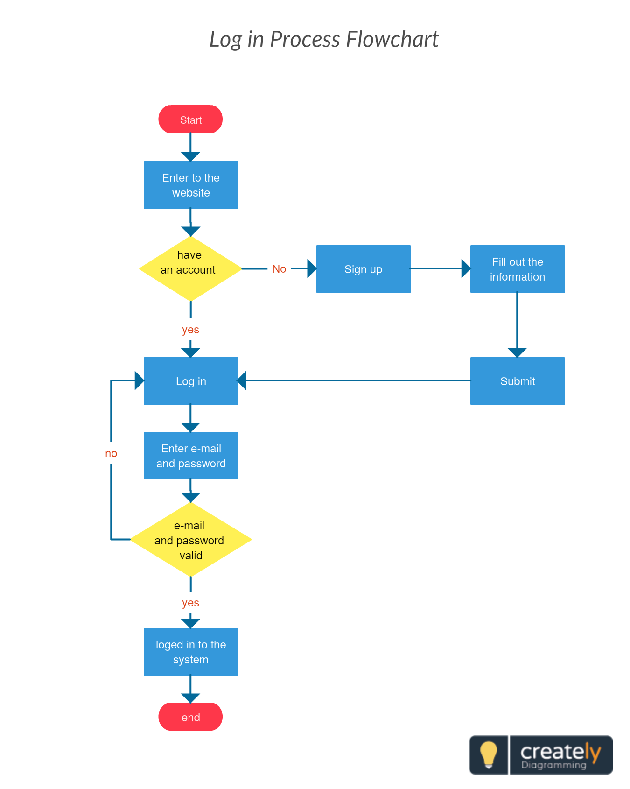
Design(Contd…)

Slide 11
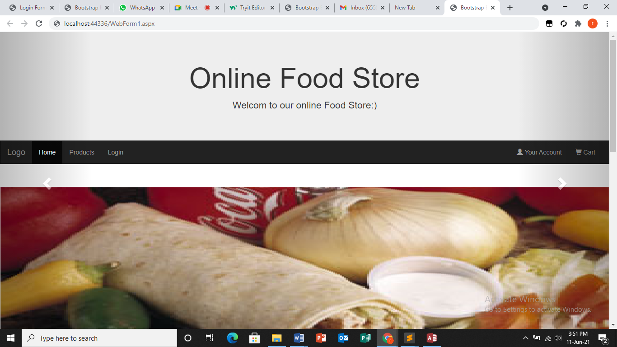
Home page:

Slide 12
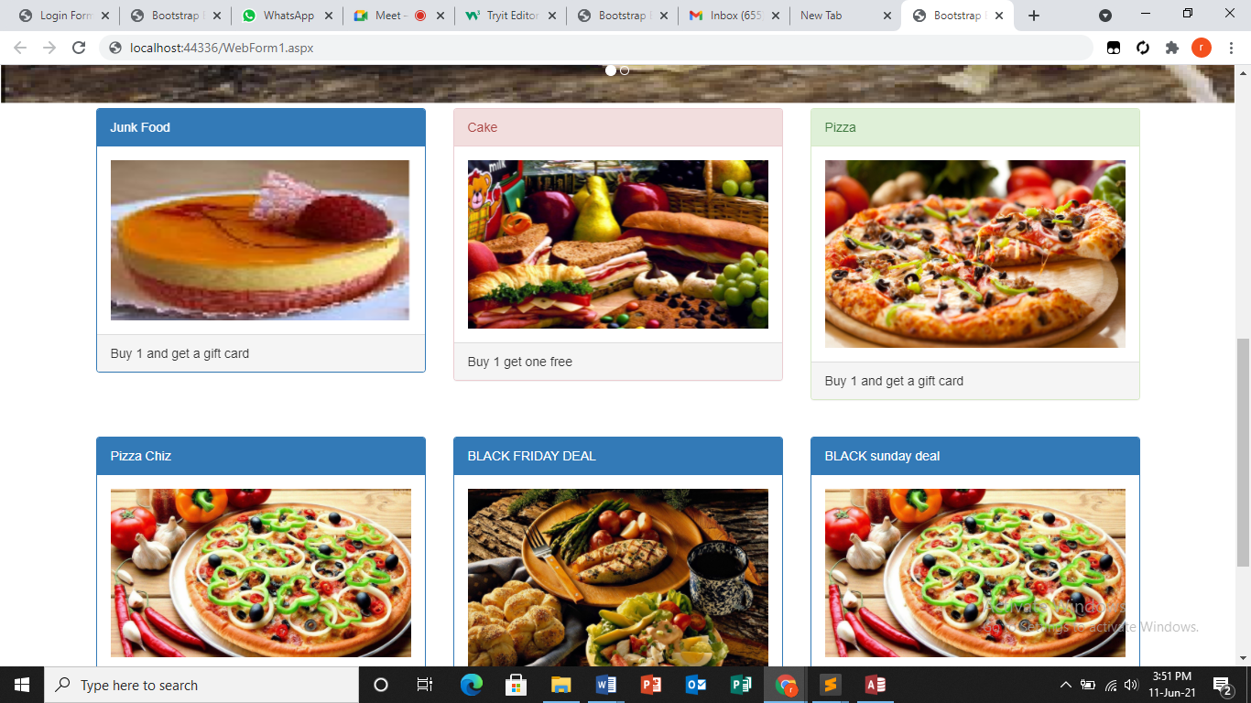
Conted…

Slide 13
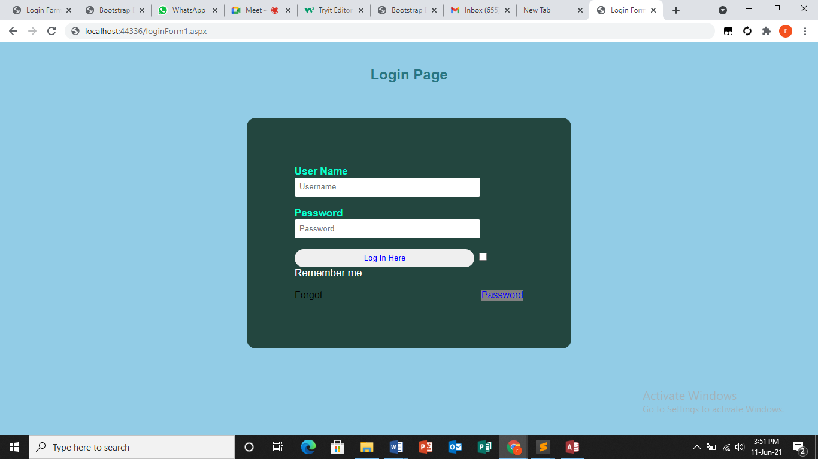
Login page:

Slide 14
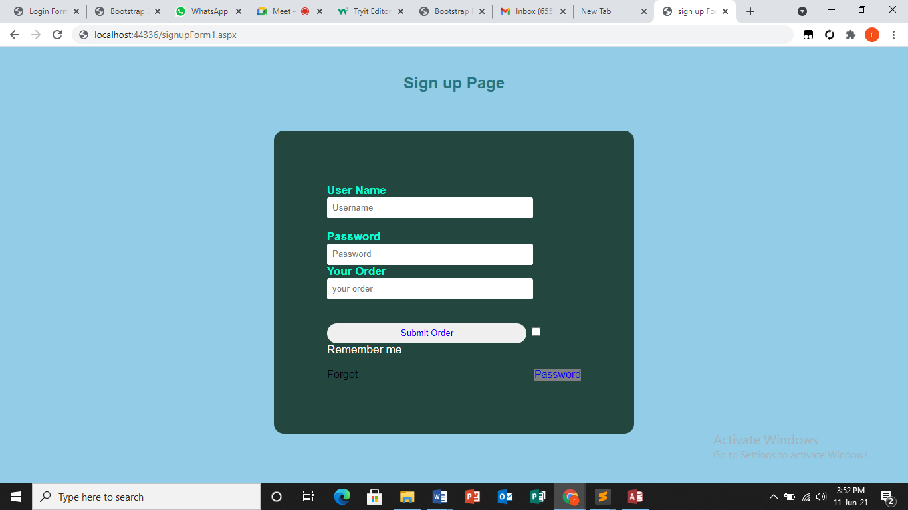
Signup page:

Slide 15
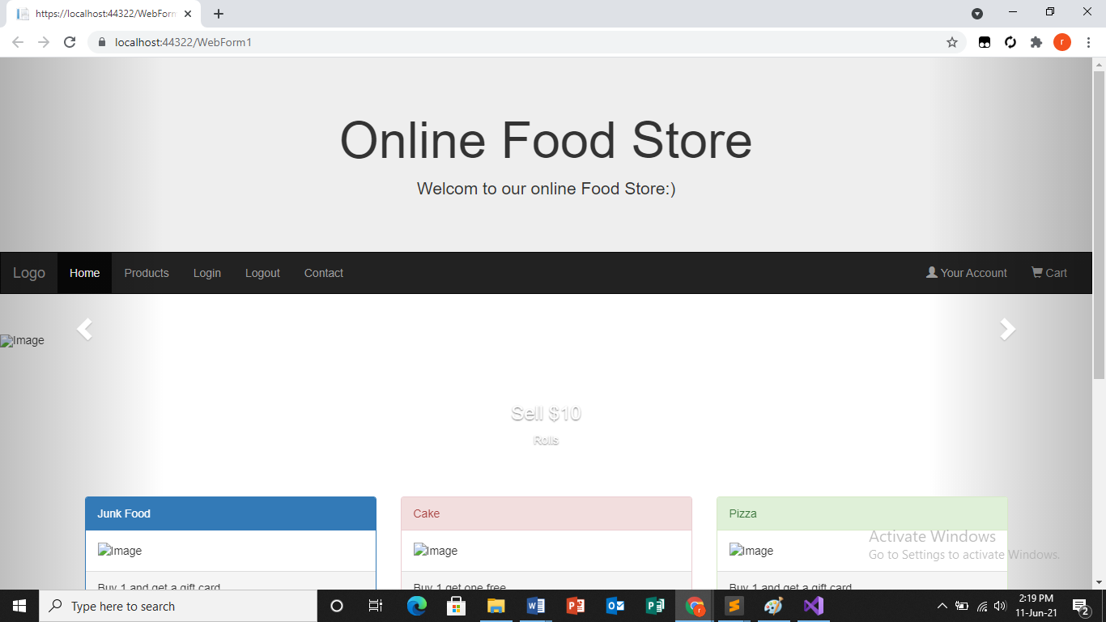

Slide 16
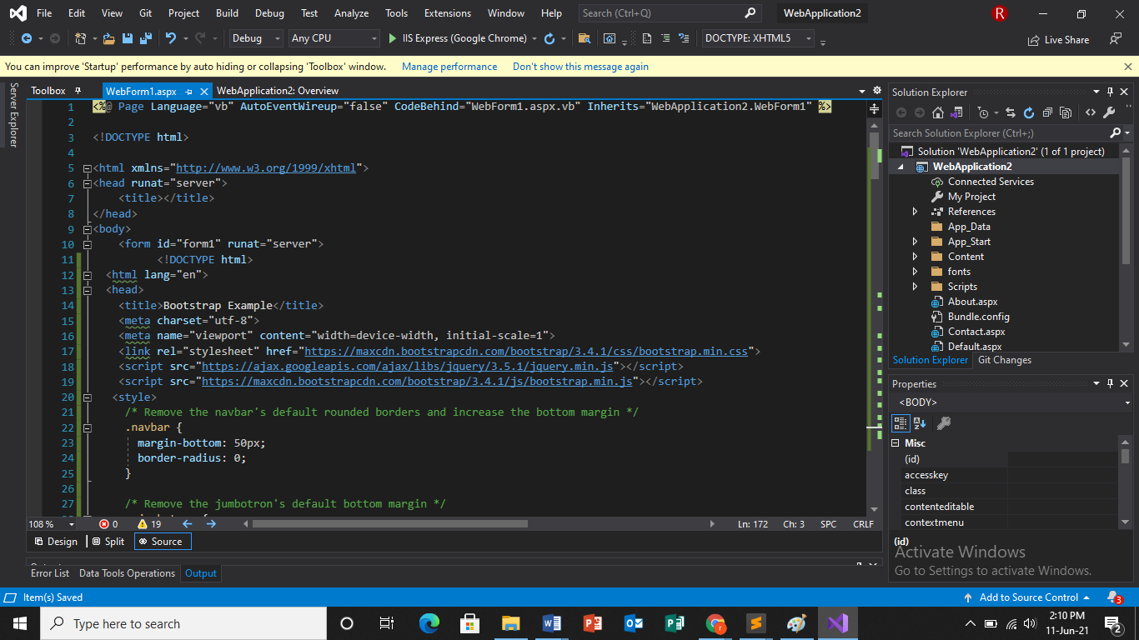
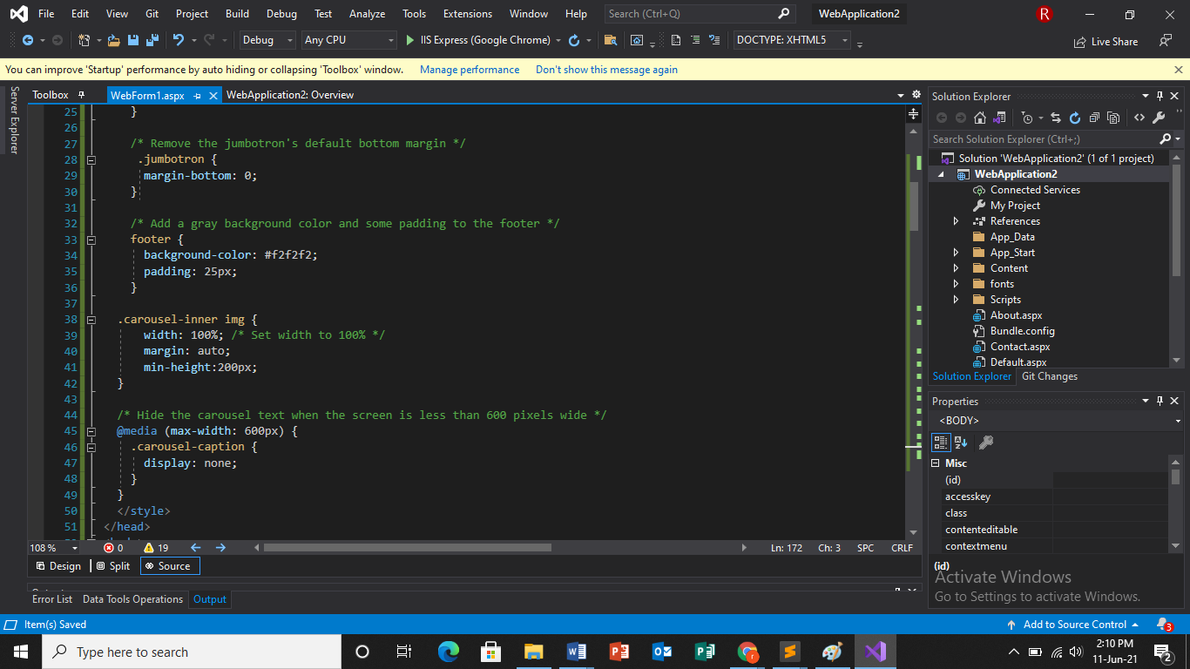

Slide 17
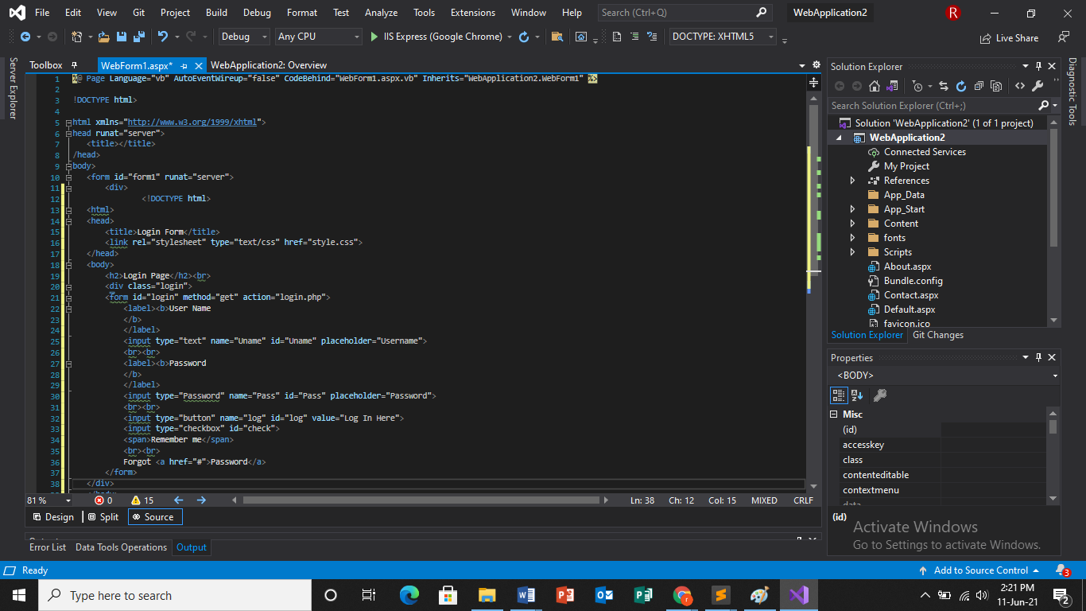
Login page:

Slide 18
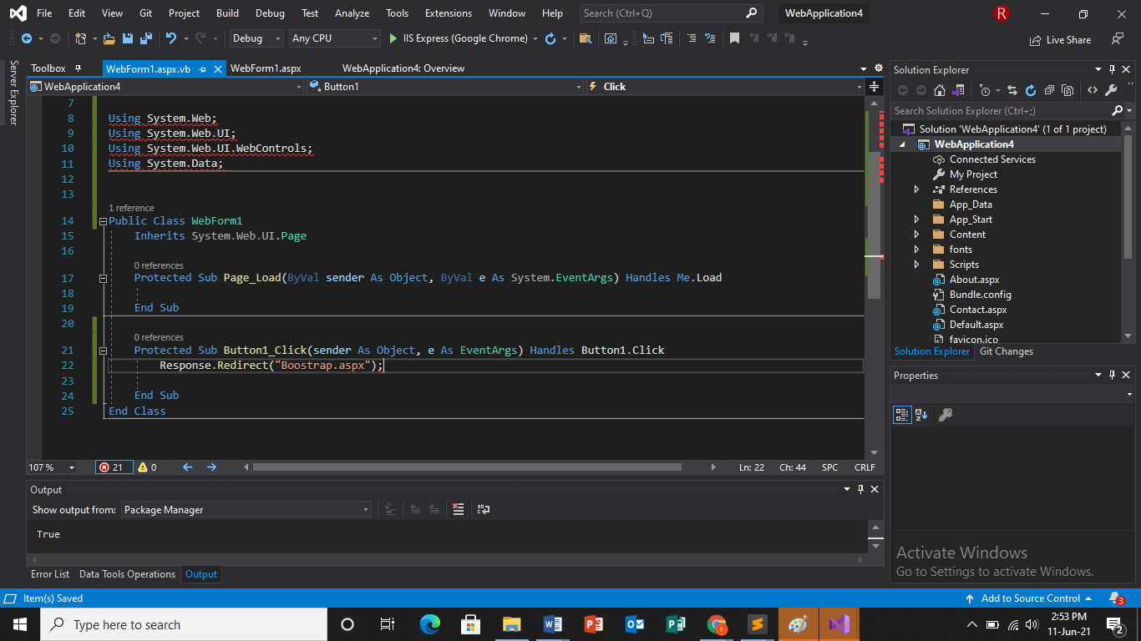
Redirected page:

Slide 19
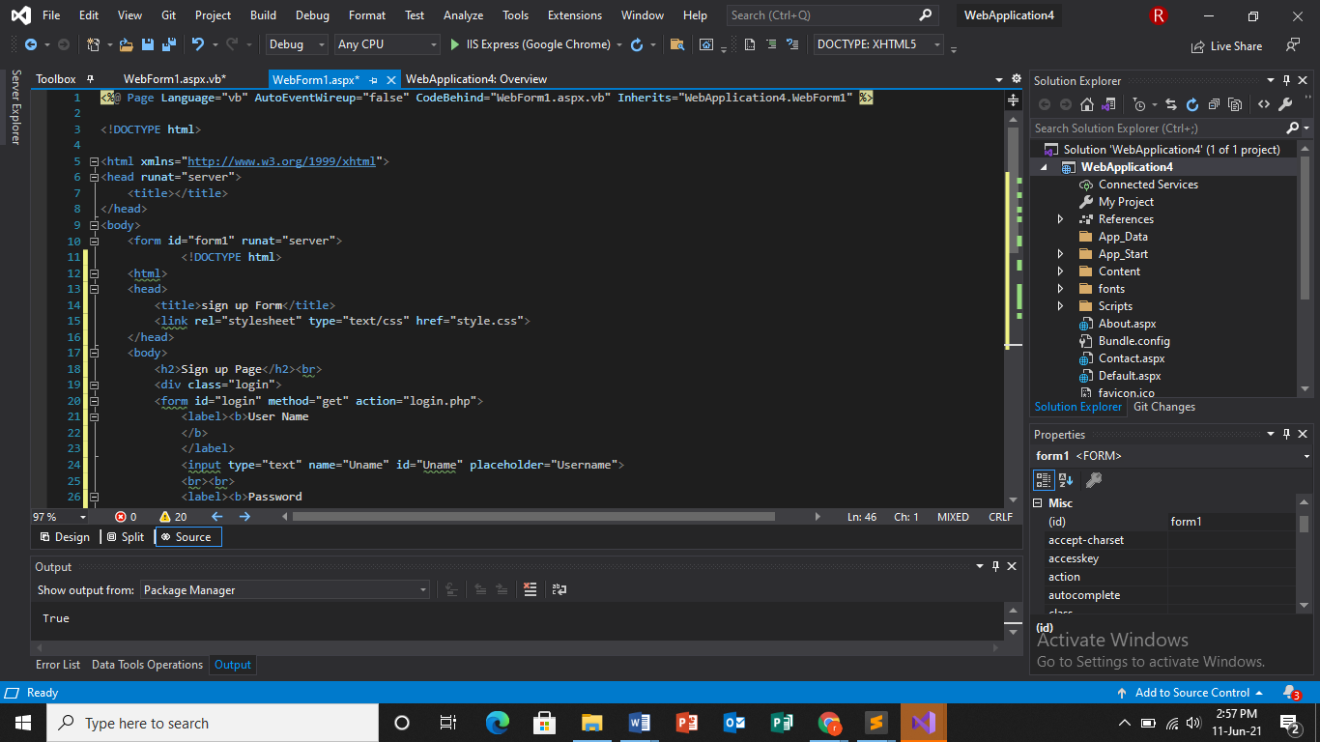
Signup page :

Slide 20
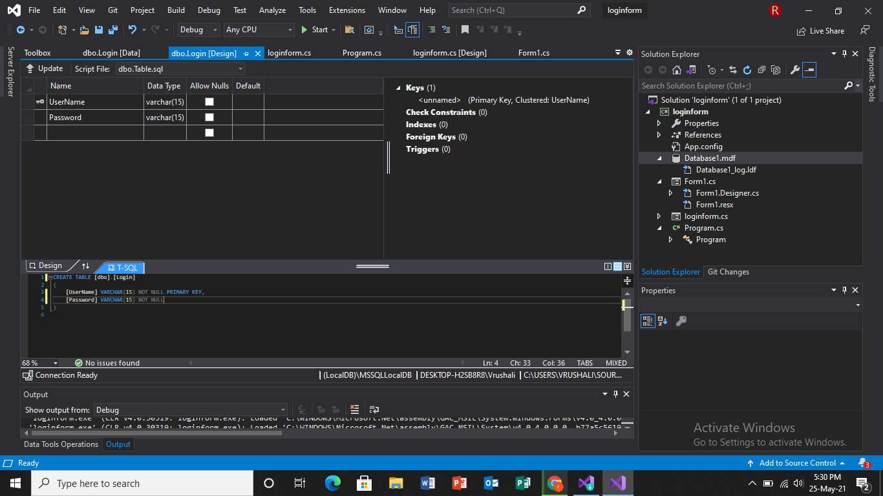
database

Slide 21
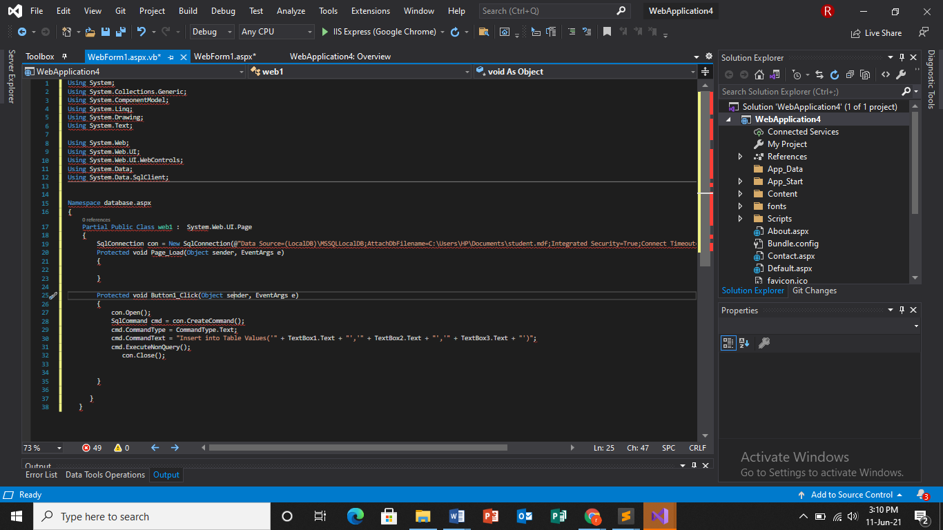
Conted…

Slide 22
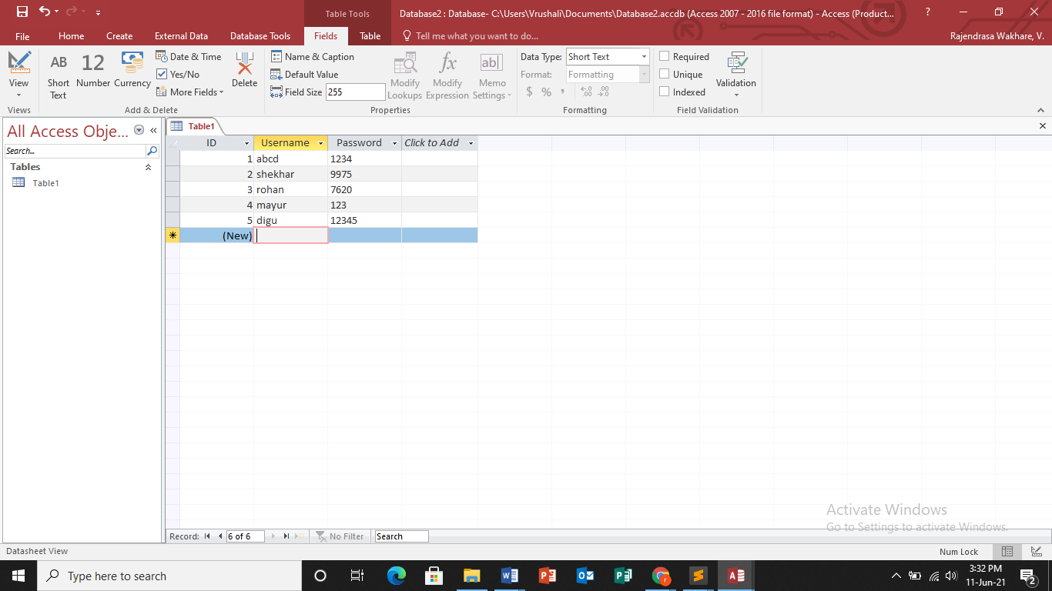
Ms acess

Slide 23
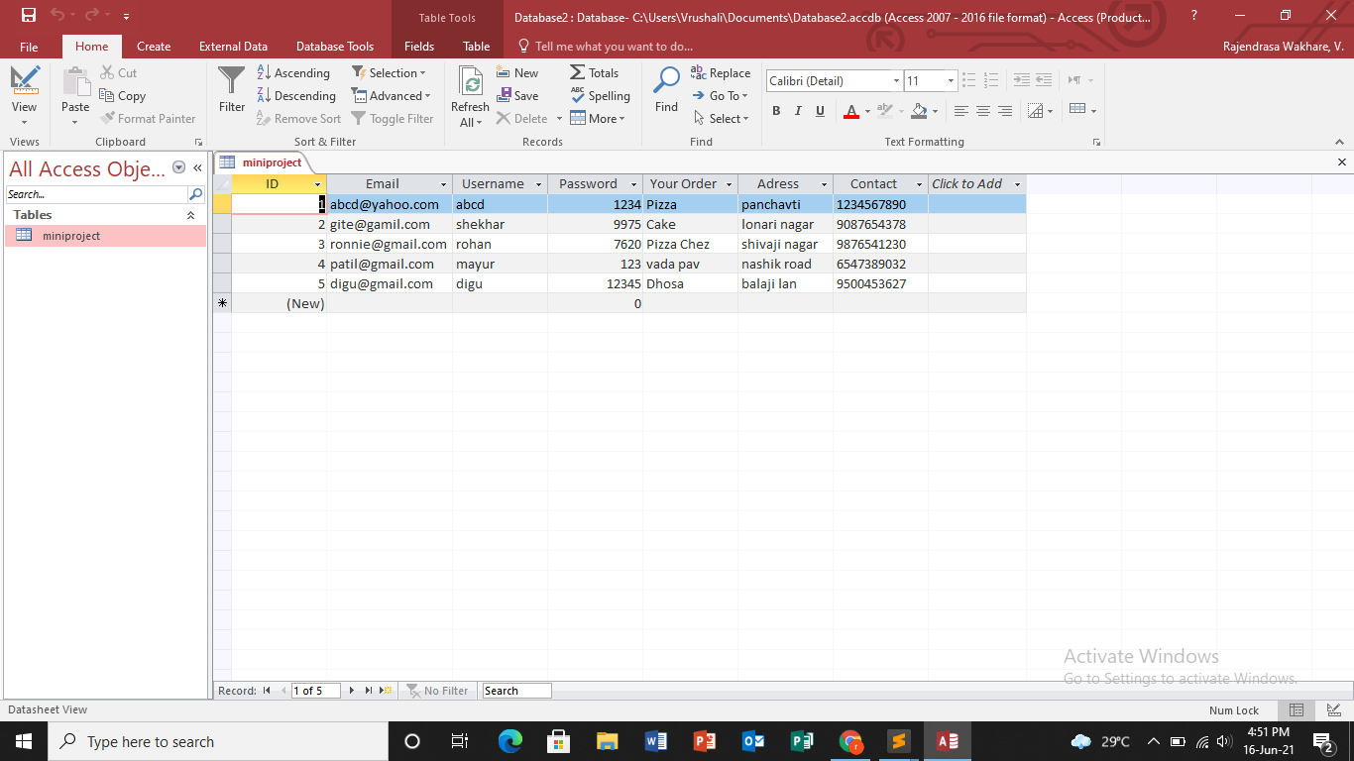
Conted…

Slide 24
FUTURE SCOPE AND LIMITATION
Easy use of customerComputerized Entry Of Details.
User Friendly Interaction between User and System.
Easy access to any stage.
Security Provided.
Lot of time is getting saved.
Easy backup of data.
Easy access for exotic & authentic product .

Slide 25
Thank you…

